Slide 1
Incident Prediction
Team Name = T4
Mentor Name = Kavi Priya , Vinod
Date : 02/07/2021
Members
Akash Babar
Ankur Choudhary
Ashlesha Datir
Damini Shirsath
Mahesh Chaudhari

Slide 2
Business Problem:
To predict the impact of the incident raised by the customer.
Objective:
To predict an impact on the basis of event log of an incident management process extracted from a service desk platform of an IT company.

Slide 3
Project Architecture:
Problem identification
Decide on a problem
Data identification
Acquire data
Clean data
Extract features
Pre-processing
Deal with missing data
Feature engineering
Generate models
Model
processing
Select final model
Evaluate final model
Application
Use model

Slide 4
Exploratory Data Analysis (EDA) and
Feature Engineering

Slide 5
Python Libraries Used:
Numpy
Pandas
Seaborn
Matplotlib
Sklearn
imblearn

Slide 6
Data set details:
##code to find shape of the dataset
data.shape
Output ➔(141712 , 36)
Therefor from the above there are 141712 rows and 36 columns are present in the give incident_event_log dataset.
Column names:
1.number
2.incident_state
3.active
4.reassignment_count
5.reopen_count
6.sys_mod_count
7.made_sla
8.caller_id
9.opened_by
10.opened_at
11.sys_created_by
12.sys_created_at
13.sys_updated_by
14.sys_updated_at
15.contact_type
16.location
17.category
18.subcategory
19.u_symptom
20.cmdb_ci
21.impact
22.urgency
23.priority
24.assignment_group
25.assigned_to
26.knowledge
27.u_priority_confirmation
28.notify
29.problem_id
30.rfc
31.vendor
32.caused_by
33.closed_code
34.resolved_by
35.resolved_at
36.closed_at

Slide 7
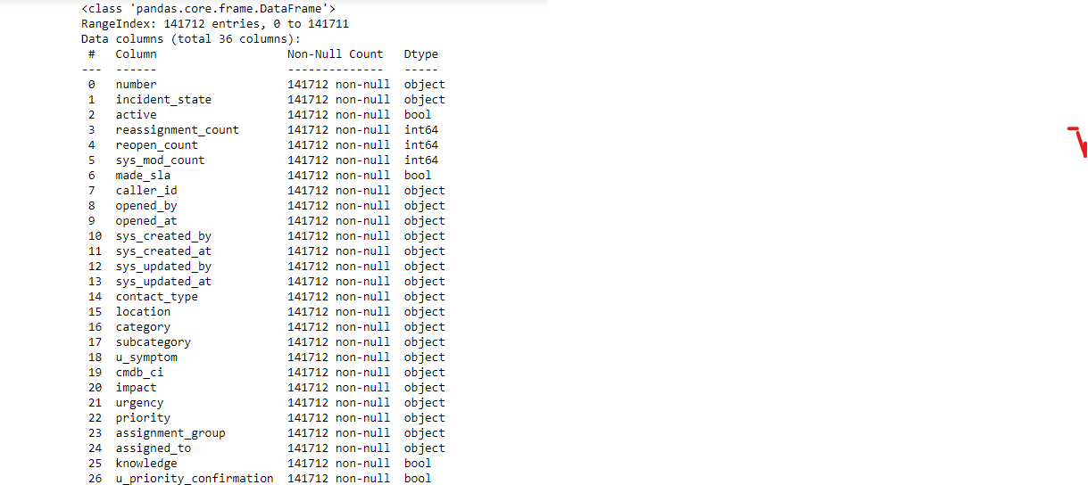
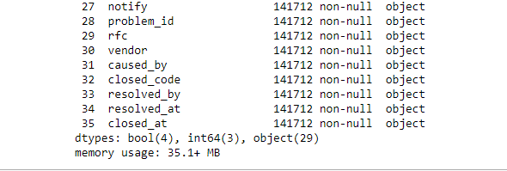
Data Information:
To find the info about the data used the code
data.info() ➔
Here object, bool , int type of data preasent

Slide 8
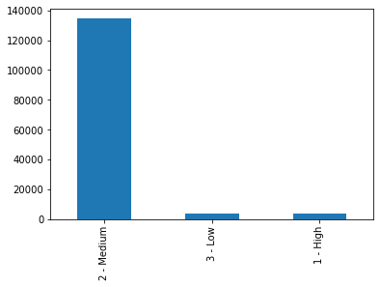
Data Visualization
Visualization of dataset :
Bar plot:
df2['impact'].value_counts().plot.bar()
From the given output it is clear that all data is concentrate in the medium values of impact ,
Therefore we can say that the data is imbalanced

Slide 9
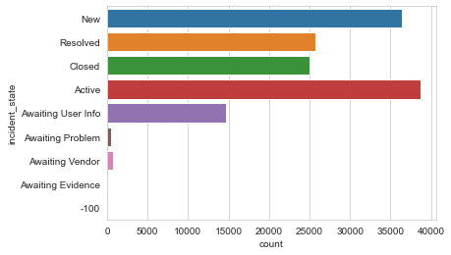
Impact on incident_state :
Incident state New and Active have high impact .
Awaiting Problem ,Awaiting Vendor and Awaiting Evidence has low impact.
Rest have medium impact.

Slide 10
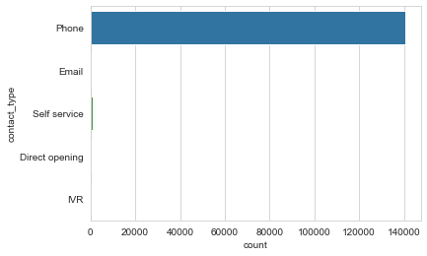
Impact on Contact_Type :
Most of the customer’s contacted via phone.

Slide 11
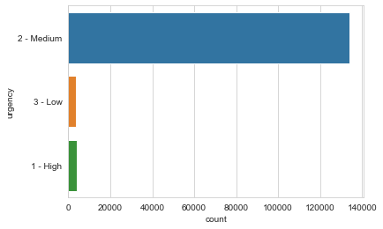
Impact on urgency :
Visualization of the level of urgency.

Slide 12
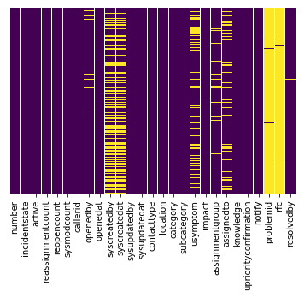
Missing Values:
Roughly 40 percent of the syscreatedby and syscreatedat data is missing.
looking at column usersymptom and assignedto less amount of data is missing nearly around 10% of data.
Looking at the problem id , rfc it looks like we are just missing too much of that data nearly 99% of data to do something useful with at a basic level.
We'll probably drop this later.
To find the missing value and visualization using heatmap :sns.heatmap(df.isnull(), cbar=False)

Slide 13
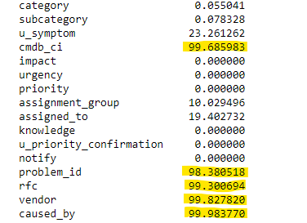
Data Cleaning:
Drop Columns:
Drop columns with more than 90% missing values
caused_by
rfc
vendor
cmdb_ci
problem_id

Slide 14
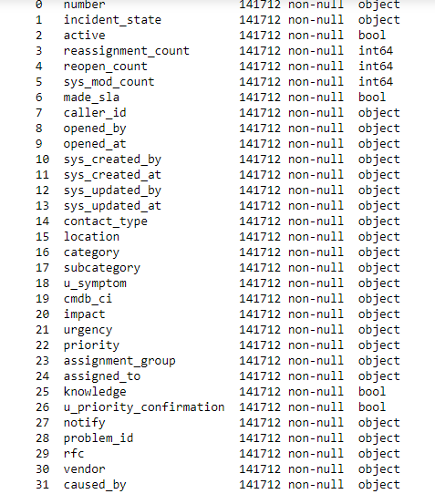
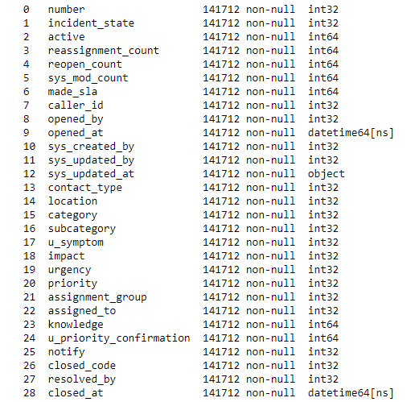
Converting Object to Integer:
OneHotLableEncoder

Slide 15
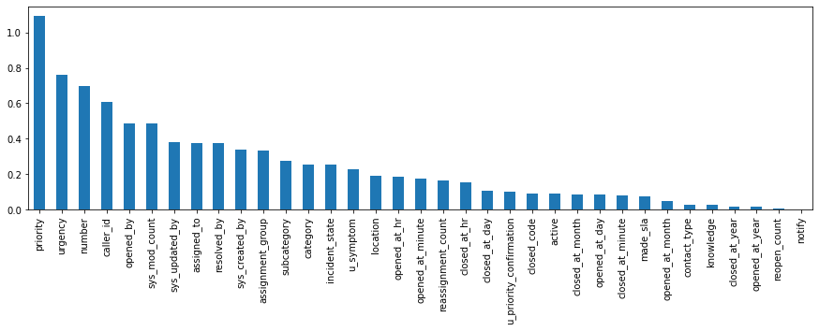
Feature for consideration :
Algorithm used: mutual_info_classif
priority 1.092835
urgency 0.762983
number 0.697378
caller_id 0.606936
opened_by 0.486160
sys_mod_count 0.484496
sys_updated_by 0.379297
assigned_to 0.374654
resolved_by 0.374008
sys_created_by 0.337257
assignment_group 0.331575
subcategory 0.274606
category 0.254383
incident_state 0.252017
u_symptom 0.229421
location 0.191954
opened_at_hr 0.186612
opened_at_minute 0.176683
reassignment_count 0.165222
closed_at_hr 0.153511
closed_at_day 0.108135
u_priority_confirmation 0.102643
closed_code 0.090624
active 0.089004
closed_at_month 0.087445
opened_at_day 0.085613
closed_at_minute 0.081194
made_sla 0.072851
opened_at_month 0.048975
contact_type 0.027660
knowledge 0.025460
closed_at_year 0.016844
opened_at_year 0.015752
reopen_count 0.004109
notify 0.000000
dtype: float64

